Slide 1
模型图

Slide 2
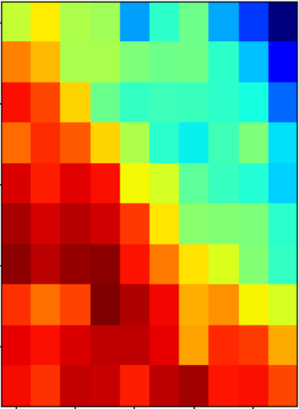
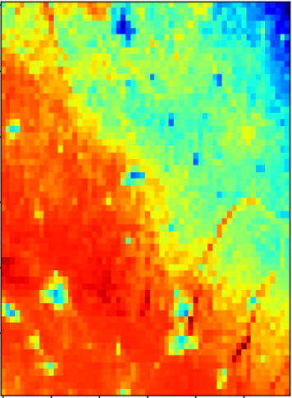
残差块×16
input
插值采样×1.5
Conv
PReLU
Conv
PReLU
Conv
Conv
Sigmoi
BN
Conv
上采样×2
BN
leakyReLU
低分辨率
高分辨率
跳跃连接

Slide 3
×2
特征融合层
Conv2d
Conv2d
Fused
Conv2d
input
Swish
Swish
Fused_Conv
Upsample
1
32
Swish
32
32
64
1
低分辨率
超分辨率
分支特征

Slide 4
低分辨率图像
低分辨率图像的
n个特征图
高分辨率图像的
n个特征图
超分辨率图像
f1×f1
f2×f2
f3×f3
提取像素块
非线性映射
图像重建

Slide 5
input
input
lstm
187
embedding
128
256
Swish
256
lstm
128
attention
128
×2
128
128
attention
dropout
128
128
lstm
Swish
64
dropout
dropout
128
fc
64
fc
1
5
sigmoid
output
output

Slide 6
ResNet50
AlexNet
input
input
STAGE 0
features
冻
结
avgpool
Layer 4
Layer 3
Layer 2
Layer 1
×4
2048
4096
fc 1
linear 1
1000
1000
1000
fc 2
1000
linear 2
2
2
output
output

Slide 7
函数图、曲线图

Slide 8
Notes:
Note:
This is a simple round rectangle that can represent some process, operation, or transformation
Author: Elvis Saravia (ellfae@gmail.com)

Slide 9
Notes:
Note:
This can be used to represent a vector. If you want to edit the distance between each element, you can “ungroup” the shapes and then modify the distance between the individual lines.
Author: Elvis Saravia (ellfae@gmail.com)

Slide 10
Notes:
Symbolizing an embedding

Slide 11
Notes:
Note:
Can represent a neuron or some arbitrary operation
Author: Elvis Saravia (ellfae@gmail.com)

Slide 12
Notes:
Note:
These visuals can represent a multi-directional array (3D) input, tensor, etc.
Author: Elvis Saravia (ellfae@gmail.com)

Slide 13




Softmax
Convolve
Sharpen
Notes:
Note:
These visuals could represent transformations (left) or operations (right)
The visuals on the right use the Math Equations Add on for Google Slides.
If you click on the equation you are able to modify it by:
Selecting Add Ons → Math Equations → Menu
While the equation is selected, click “Connect to Equation” on the “Math Equations UI”
Then change the properties like color, size, etc.
Author: Elvis Saravia (ellfae@gmail.com)

Slide 14




Softmax
Convolve
Sharpen
Notes:
Note:
These visuals could represent transformations (left) or operations (right)
The visuals on the right use the Math Equations Add on for Google Slides.
If you click on the equation you are able to modify it by:
Selecting Add Ons → Math Equations → Menu
While the equation is selected, click “Connect to Equation” on the “Math Equations UI”
Then change the properties like color, size, etc.
Author: Elvis Saravia (ellfae@gmail.com)
Log:
Added a dark theme version of the previous slide

Slide 15
Softmax
Linear
Add & Norm
Feed
Forward
Add & Norm
Add & Norm
Feed
Forward
Multi-Head
Attention
Add & Norm
Add & Norm
Multi-Head
Attention
Masked
Multi-Head
Attention
Positional
Encoding
Positional
Encoding
Input
Embedding
Output
Embedding
Inputs
Outputs(shifted right)
Notes:
Note:
Using the same visual components from before and a few new custom ones, I was able to come up with the Transformer architecture
This is a reproduction of the Transformer architecture figure presented in the work of Vaswani et al. 2017
You can further customize it however you want
Author: Elvis Saravia (ellfae@gmail.com)

Slide 16
Softmax
Linear
Add & Norm
Feed
Forward
Add & Norm
Add & Norm
Multi-Head
Attention
Feed
Forward
Add & Norm
Add & Norm
Masked
Multi-Head
Attention
Multi-Head
Attention
Positional
Encoding
Positional
Encoding
Input
Embedding
Output
Embedding
Inputs
Outputs (shifted right)
Notes:
Note:
Using the same visual components from before and a few new custom ones, I was able to come up with the Transformer architecture
This is a reproduction of the Transformer architecture figure presented in the work of Vaswani et al. 2017
You can further customize it however you want
Author: Elvis Saravia (ellfae@gmail.com)

Slide 17
writing
I
love
coding
and
writing
I
love
coding
and
I
coding
I
love
love
Tokenize
“I love coding and writing”
Notes:
Note:
This figure aims to demonstrate the process of tokenization
If you want to change the gradient colors of this shape, you can simply click on the shape and then select “Fill color” (the bucket looking icon at the top).
This is a gradient color so you can customize however you want
Author: Elvis Saravia (ellfae@gmail.com)

Slide 18
Hidden Layers
Input Layer
a^{[2]}₁
a^{[3]}₁
Output Layer
a^{[2]}₂
a^{[3]}₂
a^{[4]}
Ŷ
X
a^{[2]}₃
a^{[3]}₃
a^{[1]}_{n}
a^{[2]}_{n}
a^{[3]}_{n}
X = A^{[0]}
A^{[1]}
A^{[2]}
A^{[3]}
A^{[4]}
Notes:
Created By @srvmshr
sourav@yahoo.com

Slide 19
Hidden Layers
Input Layer
a^{[1]}₁
a^{[2]}₁
a^{[3]}₁
Output Layer
a^{[1]}₂
a^{[2]}₂
a^{[3]}₂
a^{[4]}
Ŷ
X
a^{[1]}₃
a^{[2]}₃
a^{[3]}₃
a^{[1]}_{n}
a^{[2]}_{n}
a^{[3]}_{n}
X = A^{[0]}
A^{[4]}
A^{[1]}
A^{[2]}
A^{[3]}
Notes:
Original by @srvmshr
sourav@yahoo.com
Dark themed version by (Elvis Saravia - ellfae@gmail.com)

Slide 20
Hidden Layers
Input Layer
^{[1}a]₁
a^{[2]}₁
a^{[3]}₁
Output Layer
a^{[1]}₂
a^{[2]}₂
a^{[3]}₂
a^{[4]}
Ŷ
X
a^{[1]}₃
a^{[2]}₃
a^{[3]}₃
a^{[1]}_{n}
a^{[2]}_{n}
a^{[3]}_{n}
X = A^{[0]}
A^{[1]}
A^{[2]}
A^{[3]}
A^{[4]}
Notes:
Created By @srvmshr
sourav@yahoo.com

Slide 21
CONV operation
MxM
ReLU
+b1
+b1
MxMX2
+b2
+b2
NxNx3
MxM
ReLU
a^{[l-1]}
a^{[l]}
Notes:
Added by @srvmshr
Sourav @ yahoo.com

Slide 22
CONV operation
MxM
ReLU
+b1
+b1
MxMX2
+b2
+b2
NxNx3
MxM
ReLU
Notes:
Added by @srvmshr
Sourav @ yahoo.com

Slide 23
Notes:
Note:
You can change the gradient of each component
Author: Elvis Saravia

Slide 24
Notes:
Note:
This is the header I use for the dair.ai NLP Newsletter
You can change the gradient of each component
Author: Elvis Saravia

Slide 25
Notes:
Note:
This is the header I use for the dair.ai NLP Newsletter
You can change the gradient of each component
Author: Elvis Saravia

Slide 26
Striding in CONV
S=1
S=2
Notes:
Created by @srvmshr
Sourav @ yahoo.com

Slide 27
Notes:
Created by @srvmshr
Sourav @ yahoo.com

Slide 29
MaxPool Same s=1
Inception Module
5x5 Same
3x3 Same
NxNx192
1x1 Same
NxNx192
NxNx128
NxNx32
NxNx64
Notes:
Created by @srvmshr
Sourav @ yahoo.com

Slide 30
t-1
t
Retraining w/o expansion
Notes:
Note:
1 hidden layer neural network
Author: Elvis Saravia (ellfae@gmail.com)

Slide 31
No-Retraining w/ expansion
Partial Retraining w/ expansion
Notes:
Note:
1 hidden layer neural network
Author: Elvis Saravia (ellfae@gmail.com)

Slide 32
t-1
t
t-1
t
No-Retraining w/ expansion
Partial Retraining w/ expansion
Notes:
Note:
1 hidden layer neural network
Author: Elvis Saravia (ellfae@gmail.com)

Slide 33
t-1
t
t-1
t
t-1
t
Retraining expansion
No-Retraining expansion
Partial Retraining expansion
Notes:
Note:
1 hidden layer neural network
Author: Elvis Saravia (ellfae@gmail.com)

Slide 34
Size
Family?
X
Y
#bed
Walk?
PRICE ŷ
Basic Neuron Model
ZIP
School
How does NN work (Insprired from Coursera)
Wealth
Ŷ = 0
X
Logistic Regression
Ŷ = 1
Notes:
By @srvmshr
sourav@yahoo.com

Slide 35
Linear regression
ReLU(x)
$
$
Size
Size
Notes:
By @srvmshr
sourav@yahoo.com

Slide 36
Training
CONV
3
CONV
1
CONV
2
CONV
5
CONV
6
CONV
7
I
I1
CONV
4
128*128*1
128*128*1
Encoder
Decoder
Decoder
V1
V
ENcoder
128*128*1
128*128*1
Notes:
By @srvmshr
sourav@yahoo.com

Slide 37
Large NN
Med NN
η
Small NN
SVM,LR etc
Amount of Data
Why does Deep learning work?
Notes:
By @srvmshr
sourav@yahoo.com

Slide 38
Hidden
Input
Output
a^{[1]}₁
a^{[1]}₂
One hidden layer neural network
X
a^{[2]}
Ŷ
a^{[1]}₃
a^{[1]}₄
X = A^{[0]}
A^{[1]}
A^{[2]}
Notes:
By @srvmshr
sourav@yahoo.com

Slide 39
a^{[1]}₁
x_{[1]}
a^{[2]}
a^{[1]}₂
x_{[2]}
x_{[1]}
x_{[2]}
x_{[3]}
Neural network templates
Notes:
By @srvmshr
sourav@yahoo.com

Slide 40
a^{[1]}₁
x_{[1]}
a^{[2]}
a^{[1]}₂
x_{[2]}
x_{[1]}
x_{[2]}
x_{[3]}
Neural network templates
Notes:
By @srvmshr
sourav@yahoo.com

Slide 41
Train
Valid
Test
Underfitting
Good fit
Overfitting
x2
x2
x2
x1
x1
x1
Train-Dev-Test vs. Model fitting
Notes:
By @srvmshr
sourav@yahoo.com

Slide 42
x_{[1]}
x_{[2]}
a_{[L]}
DropOut
x_{[3]}
x2
r=1
x2
Normalization
x1
x1
Notes:
By @srvmshr
sourav@yahoo.com

Slide 43
J
w2
Early stopping
Err
w1
w1
w2
Before Normalization
Dev
Train
it.
J
w2
w1
w1
After Normalization
w2
Notes:
By @srvmshr
sourav@yahoo.com

Slide 44
x₁
x₂
w[L]
w[1]
w[2]
w[L-2]
w[L-1]
Deep neural networks
FN
TN
TP
FP
Understanding
Precision & Recall
Notes:
By @srvmshr
sourav@yahoo.com

Slide 45
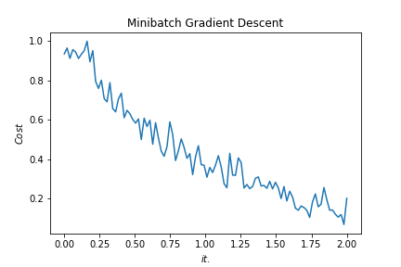
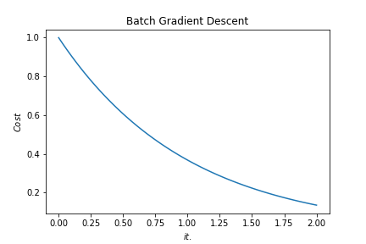
Batch vs. Mini-batch Gradient Descent
w2
w2
BGD
SGD
Batch Gradient Descent vs. SGD
SGD
w1
w1
Notes:
By @srvmshr
sourav@yahoo.com

Slide 46
x_{[1]}
p_{[1]}
x_{[2]}
p_{[2]}
x_{[3]}
Softmax Prediction with 2 outputs
Notes:
By @srvmshr
sourav@yahoo.com

Slide 47
16
16+32
16
16
1
3
Convolution 3x3
Convolution 1x1
Dropout 0.1
16
Max Pooling 2x2
Skip connection
Dropout 0.2
Up Sampling 2x2
Block copied
Dropout 0.3
32
32
32+64
32
64
64
64+128
64
128
128
128+256
128
256
256
Notes:
By @avsthiago

Slide 48
Layer1
Layer2
Layer3
Input
Output
Conv3-32
Conv3-32
Conv3-32
Conv3-32
Max-Pool
Conv3-64
Max-Pool
Conv3-128
Max-Pool
Conv3-64
FC-512
Softmax
FC
Layer4
FC
Layer3
Max-Pool
Layer1
Layer2
Layer3
Layer4
Conv
Layer2
Max-Pool
Conv3-32
Output
Conv3-32
Conv3-32
Conv3-32
Max-Pool
Conv3-64
Max-Pool
Conv3-128
Max-Pool
Conv3-64
FC-512
Conv
Layer1
Input
Notes:
By @avsthiago

Slide 49
Filter concatenation
3x3 convolutions
5x5 convolutions
1x1 convolutions
1x1 convolutions
1x1 convolutions
1x1 convolutions
3x3 max pooling
Previous layer
Notes:
By @avsthiago

Slide 50
Previous layer
1x3 conv,
1 padding
1x3 conv,
1 padding
1x7 conv,
3 padding
1x3 conv,
1 padding
1x5 conv,
2 padding
1x3 conv,
1 padding
Filter concatenation

Slide 51
Avg-Pool
Auxiliary Classifier
Conv
FC
FC
Softmax
Inception
Input
Inception
Conv
Max-Pool
Conv
Max-Pool
Conv
Max-Pool
Inception
Inception
Max-Pool
Inception
Inception
Inception
Inception
Inception
Max-Pool
Avg-Pool
Conv
FC
Softmax
Avg-Pool
Auxiliary Classifier
Conv
FC
FC
Softmax
Input
ConvTranspose2d
Max-Pool
Conv
Max-Pool
Notes:
By @avsthiago

Slide 52
Filter concatenation
Filter concatenation
3x3 conv.
1x3 conv.
3x1 conv.
1x1 conv.
3x3 conv.
3x3 conv.
1x1 conv.
1x3 conv.
3x1 conv.
3x3 conv.
1x1 conv.
1x1 conv.
Pool
1x1 conv.
1x1 conv.
Pool
1x1 conv.
1x1 conv.
Previous layer
Previous layer
(a)
(b)
Notes:
By @avsthiago

Slide 53
Previous input
Previous input
x
x
F(x)
F(x)
Stacked layers
Stacked layers
x
identity
+
y=F(x)
y=F(x)+x
R1
R1
R2
R1
R1
R2
R3
R1
R2
R3
Notes:
By @avsthiago

Slide 54
Dense Block 1
Dense Block 2
Dense Block 3
Softmax
FC
Avg-Pool
Avg-Pool
Conv
Conv
Input
Avg-Pool
Conv
Transition layers
Notes:
By @avsthiago

Slide 55
h_{i+1}
Filter concatenation
h_{i+1}
add
add
Filter concatenation
3x3 max
3x3 conv
3x3 avg
identity
add
add
add
add
add
add
add
add
3x3 conv
identity
3x3 conv
5x5 conv
3x3 avg
identity
3x3 avg
3x3 avg
3x3 conv
5x5 conv
7x7 conv
5x5 conv
3x3 max
7x7 conv
3x3 avg
5x5 conv
h_{i}
h_{i}
...
...
h_{i-1}
h_{i-1}
(a)
(b)
Notes:
By @avsthiago

Slide 56
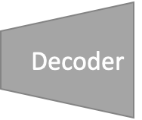
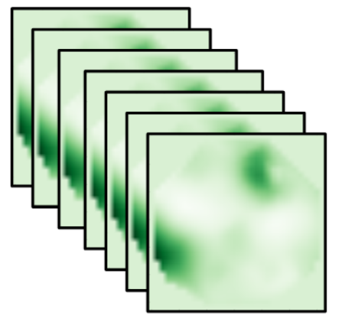
=
14*14
28*28
56*56
112*112
224*224
Notes:
By @avsthiago

Slide 57
Notes:
By @avsthiago
Dark-theme version of the previous (by Elvis Saravia)

Slide 58
Max(1,1,5,6) = 6
Y
1
1
2
4
5
6
7
8
6
8
3
2
1
0
Pooling performed with a 2x2 kernel and a stride of 2
3
4
1
2
3
4
X
Image Representation
Notes:
By @avsthiago

